Slide 1
Discrete Structures
Instructor: Zubaria Asma
Course Code: CS-335
Credit Hours: 3(3-0)
Lecture # 24

Slide 2
Mathematical
Induction

Slide 3
INTRODUCTION TO GRAPHS
Mathematical induction is a mathematical proof technique, a form of direct proof, usually done in two steps. It is used to prove a given statement about any well-ordered set. Most commonly, the well-ordered set is the set of natural numbers. The first step, called the base case or basis, proves that the theorem is true for the number one.
The second step, called the inductive step, proves that, if the theorem is true for a given number, then it is also true for the next number.
These two steps establish the theorem for all natural numbers. The fact that these two steps prove that a theorem is true in an infinite number of cases is called the Principle of mathematical induction.

Slide 4
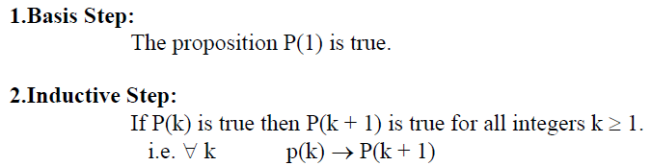
PRINCIPLE OF MATHEMATICAL INDUCTION:
Let P(n) be a propositional function defined for all positive integers n. P(n) is true for every positive integer n if

Slide 5
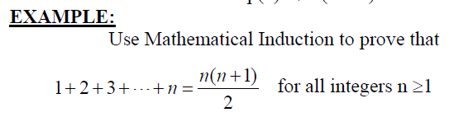
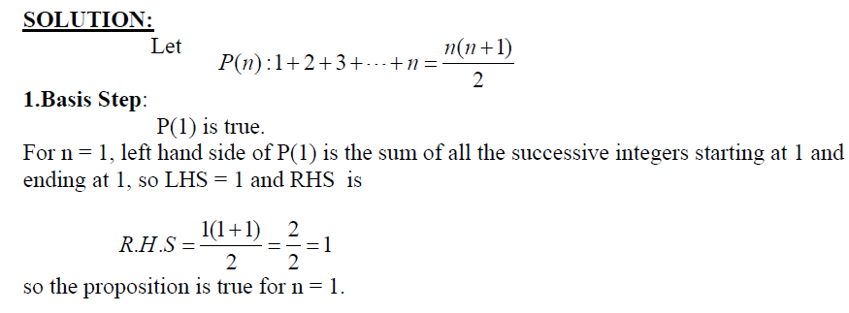

Slide 6
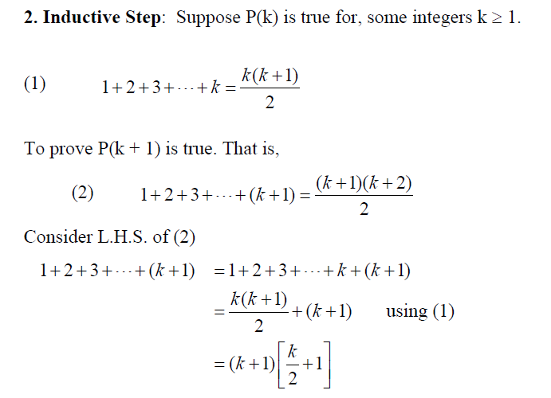

Slide 7
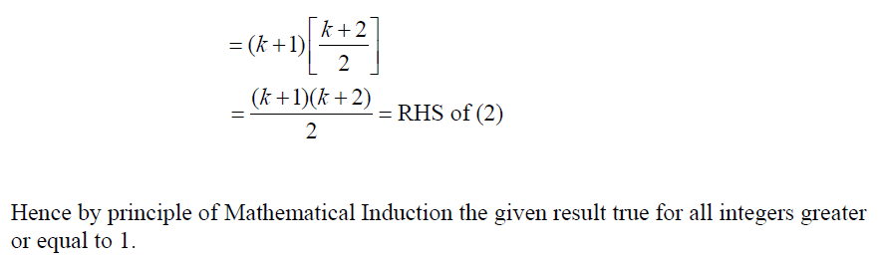

Slide 8
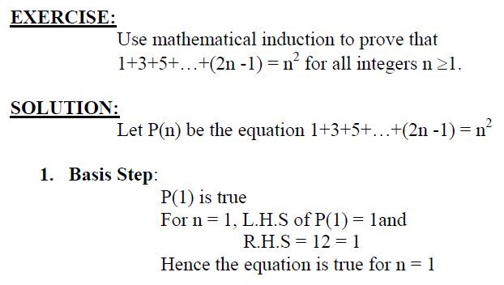

Slide 9
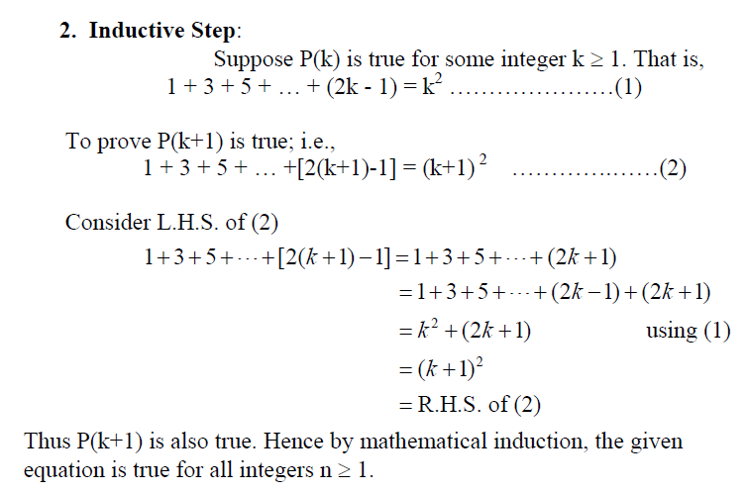

Slide 10
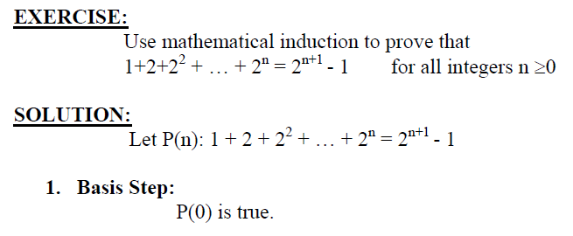
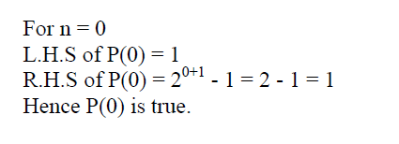

Slide 11
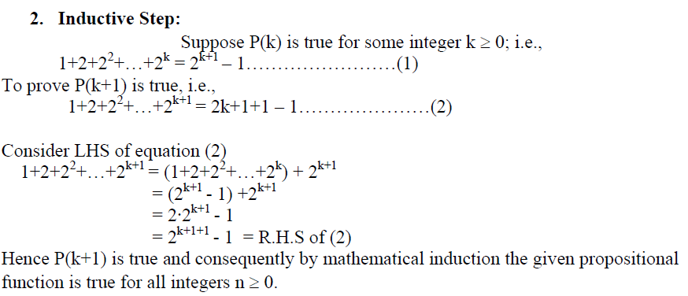

Slide 12
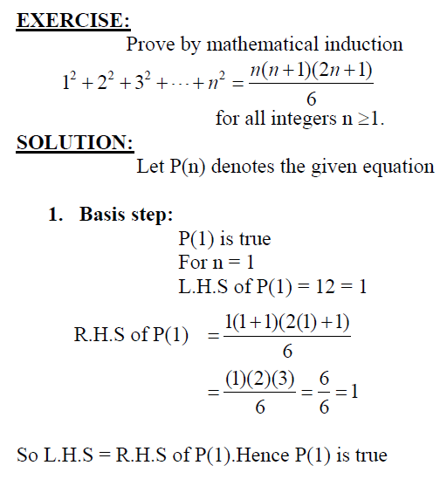

Slide 13
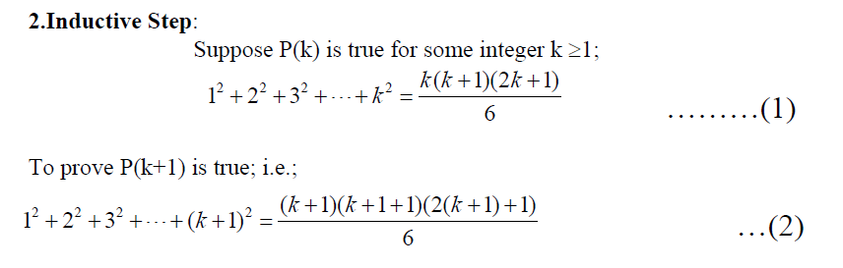

Slide 14
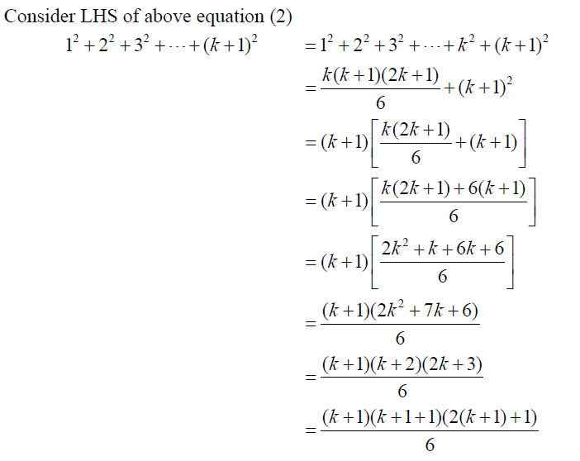

Slide 15
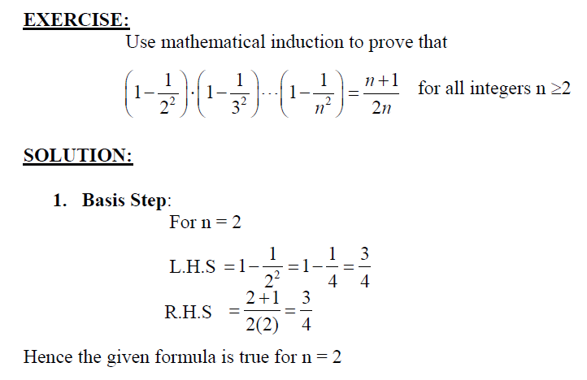

Slide 16
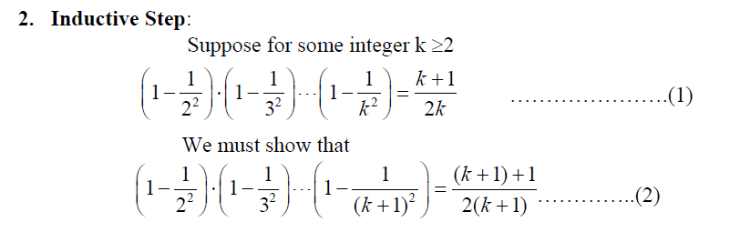

Slide 17
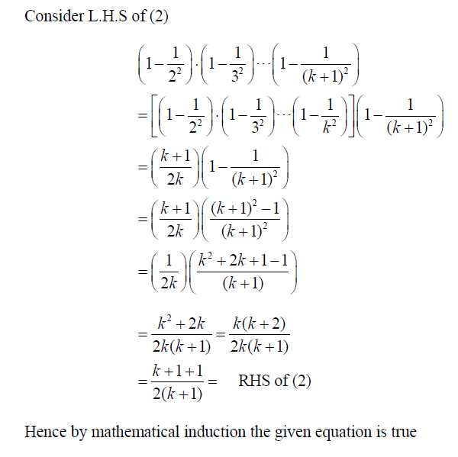

Slide 18

THANK YOU

